Slide 1
SMART PROJECT MANAGEMENT SYSTEM
2021-234

Slide 2
Overall Project Description

Slide 3
Overall Project Description
Research Problem
Current student grouping process is not effective.
Managing and checking progress of projects is a exhausting process.
Existing project management systems doesn’t include a peer review facility.
Students having difficulty to find a project.

Slide 4
Main Objective
Develop a Project Management System to improve team work skills among students and Automate current project management system.

Slide 5
Sub Objectives
Research Objectives
Develop a component to auto generate project groups to create balanced group.
Develop a component to peer review students to get an idea about each student.
Develop a component to track project progress using GitHub
Develop a component to track client meetings and record content using voice to text methodology.

Slide 6
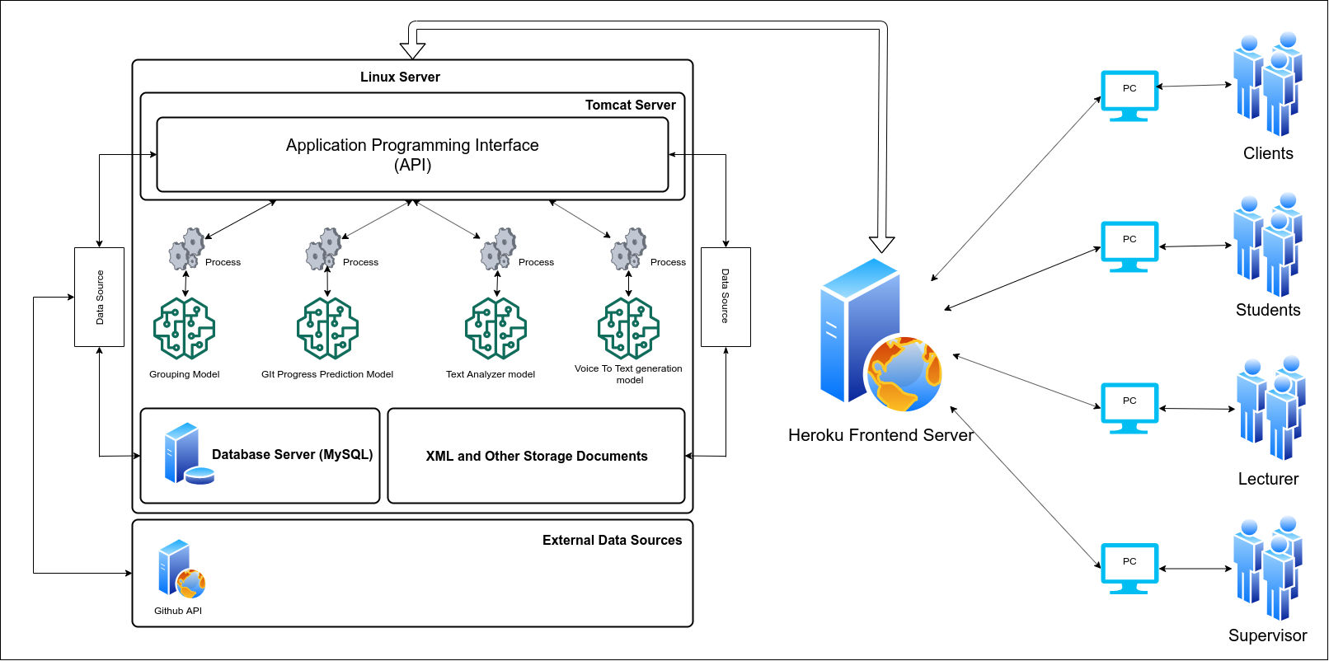
Overall Project Description
System Diagram

Slide 7

IT18009446 Amarasekara T.N.E. IT
Research Section 1
Automate Project Group Generation

Slide 8
Introduction
Research Question
Specific and Sub Objectives
EVIDENCES FOR THE COMPLETION

Slide 9

Research Question
Is random student group generation effective for group projects?
What are the other possible ways to automate group generation instead of random group generation?
What should be considered when we group students?

Slide 10
Specific and Sub Objectives
Specific Objectives
Develop a grouping algorithm to automate student grouping process
Sub Objectives
Data collection.
Analyze the data and find relationships between data.
Using data analysis find an optimal algorithm or algorithms to achieve the expected results
Test algorithms and output a model that can be used for the grouping process.

Slide 11
Research Methodology
grouping algorithm
Evidence for completion
Future work

Slide 12
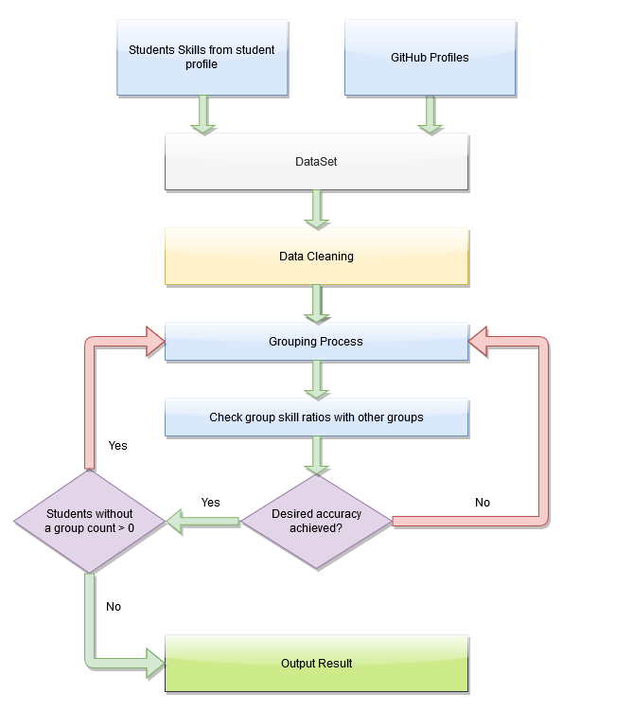
Grouping Algorithm
Data Requirements
Student GPA
Programming Skills
Base Languages
Frameworks
DBM systems
Version Controlling
Previous Projects
Used programming languages
GitHub Repositories
Used programming languages
✔
✔
✔
✔
✔

Slide 13
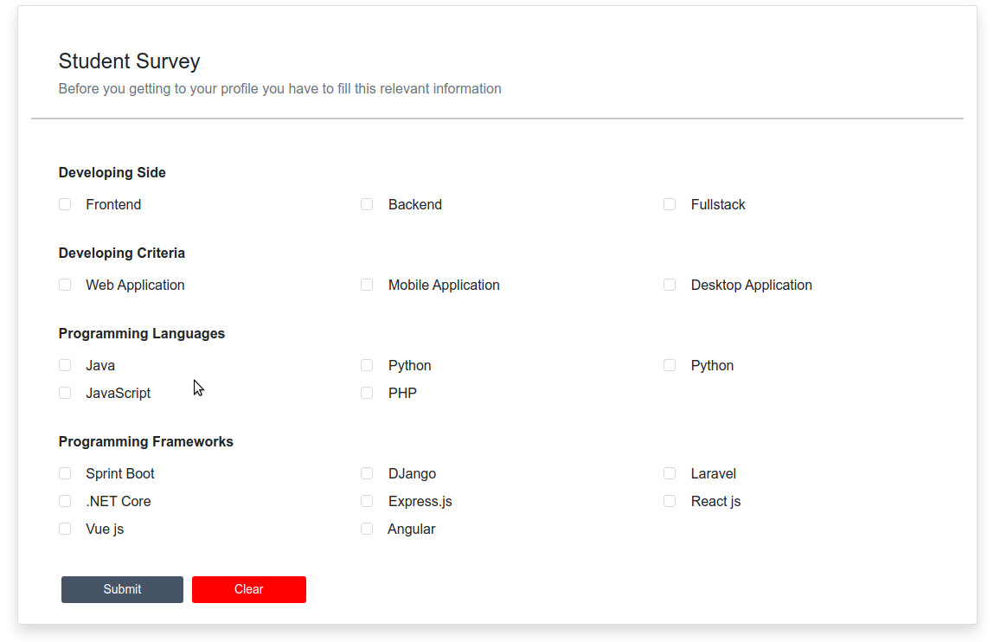
Evidence for completion
Student Skills from student profile

Slide 14
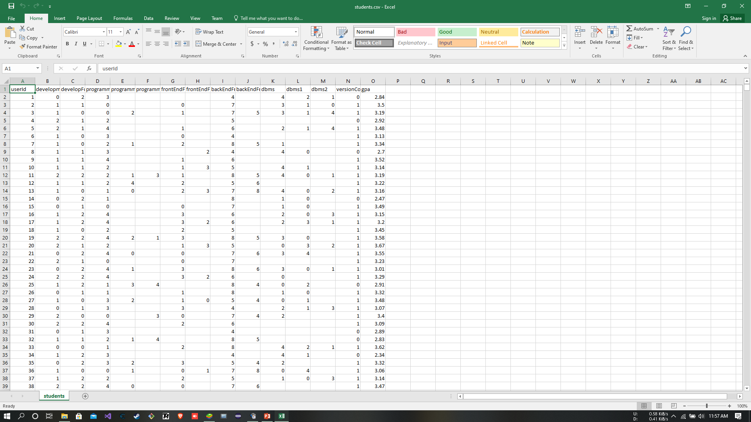
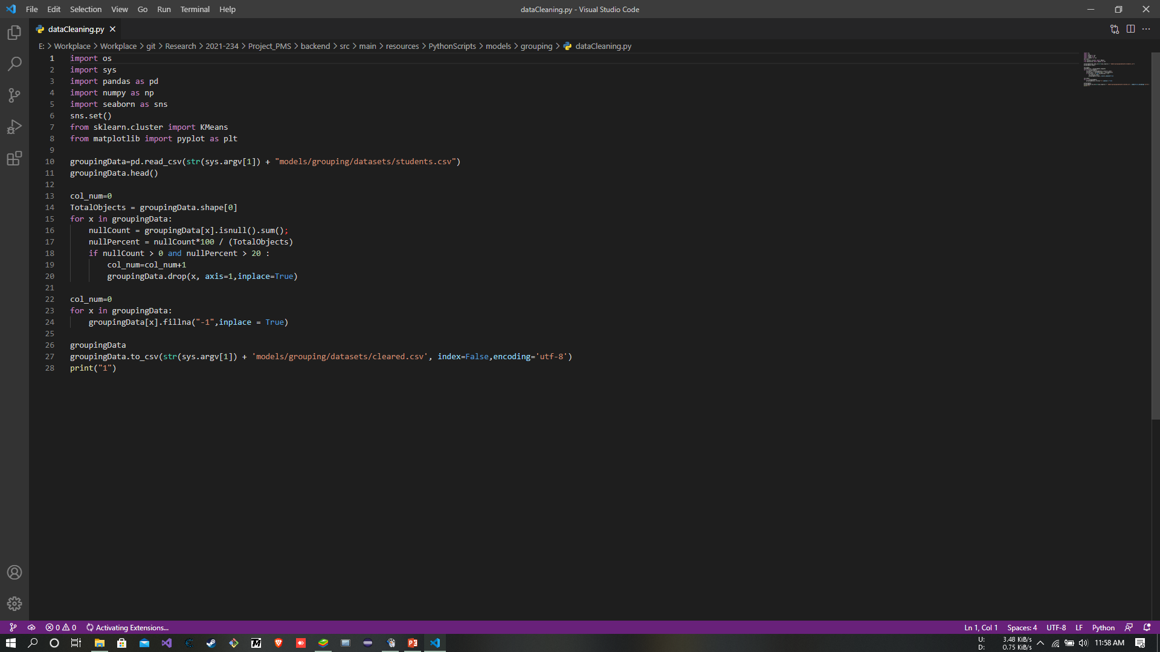
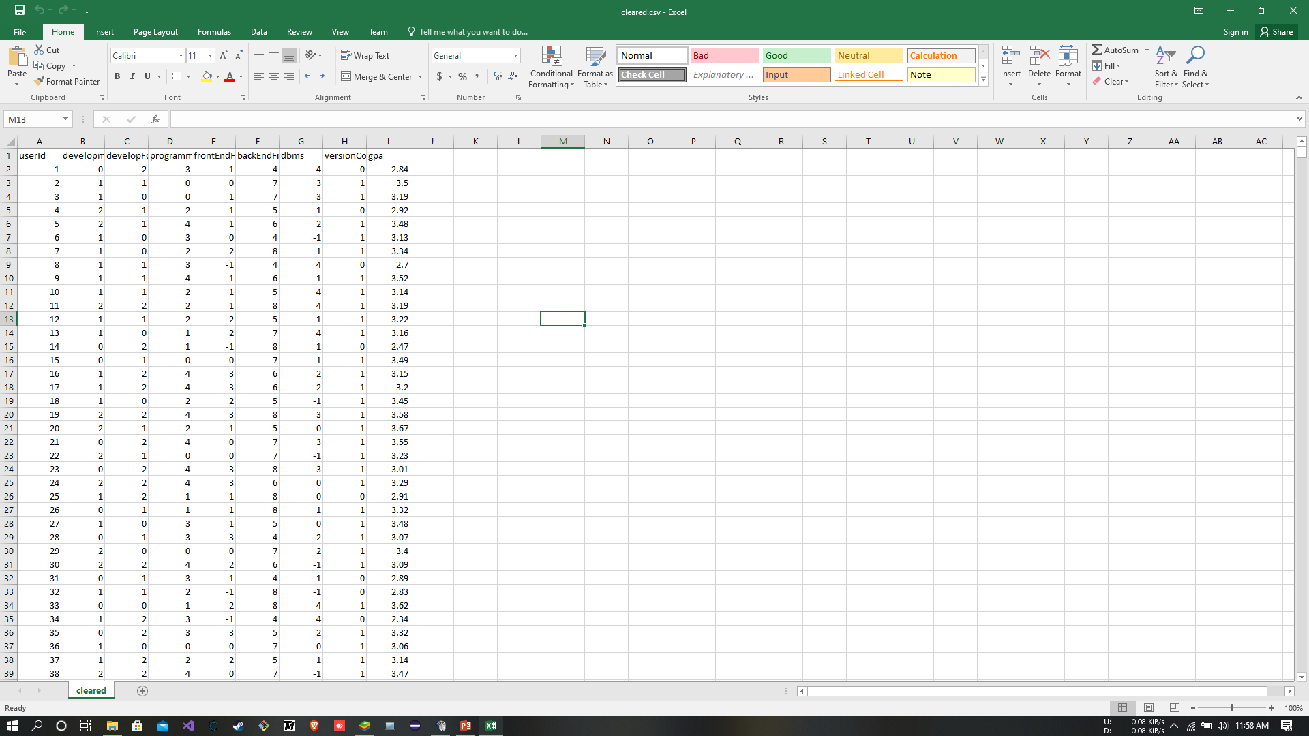
Evidence for completion
Dataset
Cleaning Process
Cleared Dataset

Slide 15
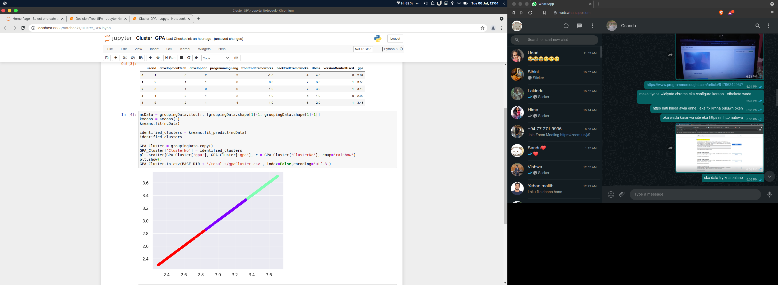
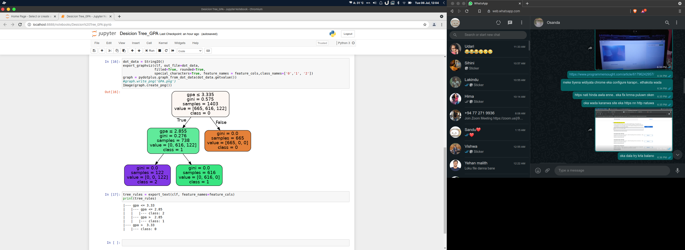
Evidence for completion
Identifying GPA Rules

Slide 16
Evidence for completion
Splitting students fairly without considering number of groups
Ex : Student count = 2005, Maximum student count per group = 8
Groups with 8 students : 2005 / 8 = 250, Remainder = 5
Create an additional group with remainder + 1 student from each other groups.
Output : Groups with 8 Students : 248
Groups with 7 Students : 3
Final Group count : 251

Slide 17
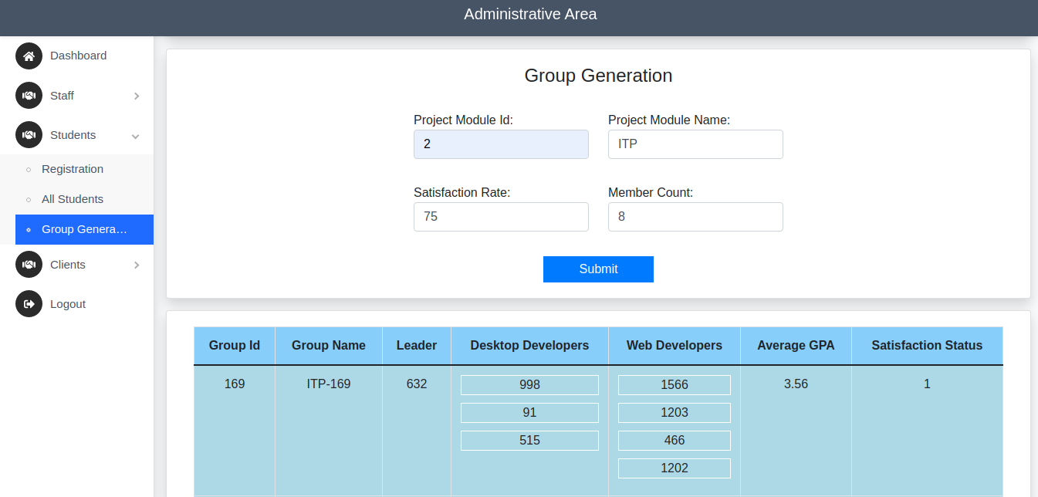
Evidence for completion
Demo Grouping Result

Slide 18
Future works
GPA Balancer
CREATE DIVERSE TEAMS

Slide 19
GPA Balancer
To ensure that the grouping process will produce student groups without any unbalanced situations. such as,
some groups may have best gpa scores and others don’t.
To achieve this we need to regulate average GPA for each group

Slide 20
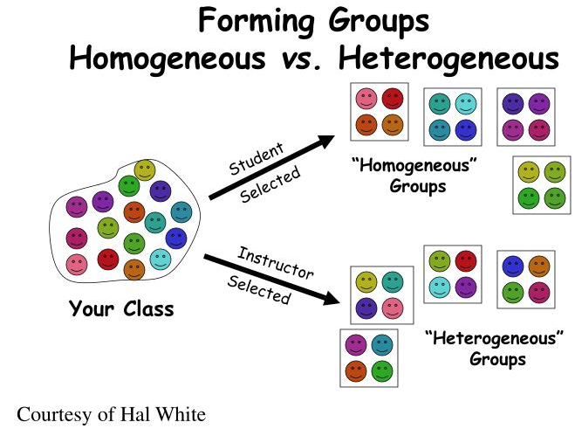
CREATE DIVERSE TEAMS
By creating student groups with various skills is
much more efficient and effective.
Advantages :
They focus more on facts
They Process those facts more carefully
They’re also more innovative

Slide 21
References
[1] Kmeans Clustering, Available at
https://scikit-learn.org/stable/modules/generated/sklearn.cluster.KMeans.html
[2] Decision Tree Classifier, Available at
https://scikit-learn.org/stable/modules/generated/sklearn.tree.DecisionTreeClassifier.html
[3] Why Diverse Teams Are Smarter, Available at
https://hbr.org/2016/11/why-diverse-teams-are-smarter

Slide 22

IT18140330 Gamage O.M. SE
Research Section 2
Predict future GitHub contribution and progress tracking

Slide 23
Introduction
Research Questions
Specific & sub Objectives

Slide 24

Research Questions
Are Students usually use any version controlling systems for their university modules?
Can we track GitHub users’ project? How we are going to track the progress?
Are there any existing project management system to predict contribution and track the project progress using GitHub?
What should be considered when we track the progress?
Are there any Incorporating version controlling facilities in project management?

Slide 25

Objectives
Predict Future Contribution and progress tracking using GitHub REST API.
Sub Objectives
Create system component to Track the project progress using GitHub REST API.
Creating Issue Tracking system similar as stack overflow.
Generating Performance report which represents individual contribution to the project by each team member

Slide 26

Research Methodology
Methodology

Slide 27
Methodology
Predict Future Contribution and Progress Tracking using GitHub REST API.
Project creation, Progress tracking.
Track the data using GitHub REST API .
Leader has to create a project Environment with a GitHub Access Token.
Students can track the Project .
Generating Future Contribution report which represents individual contribution to the project by each team member

Slide 28
Evidences
Evidences for the completion

Slide 29
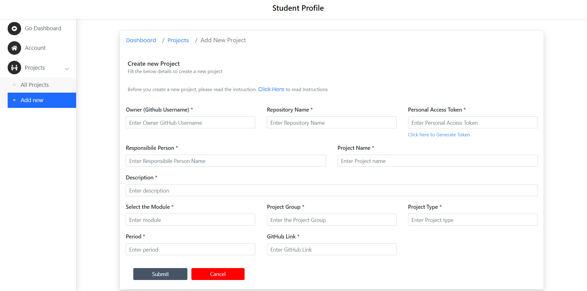
Add new Project

Slide 30
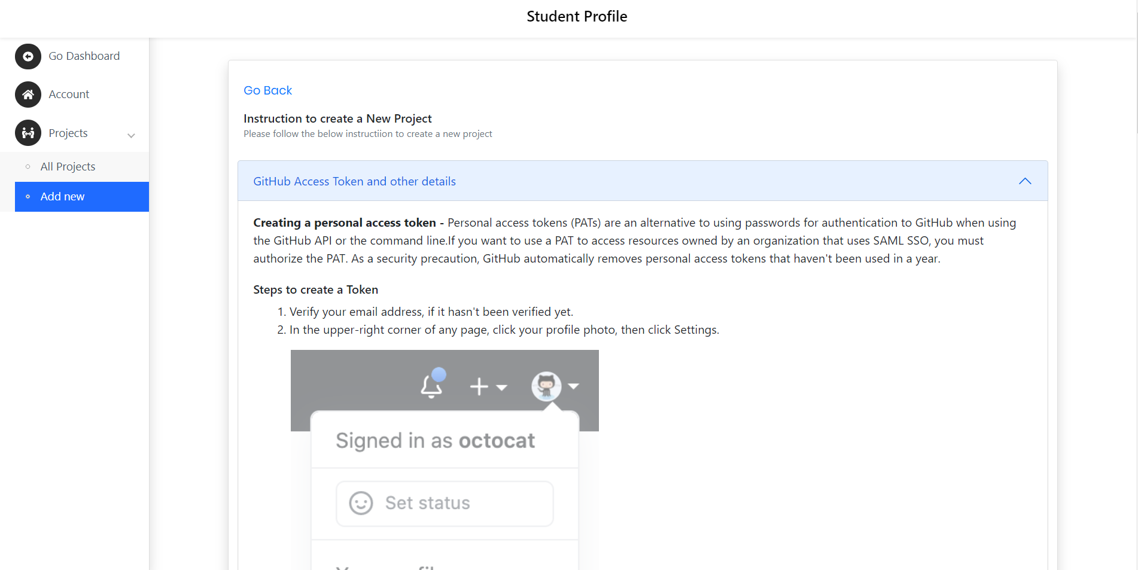
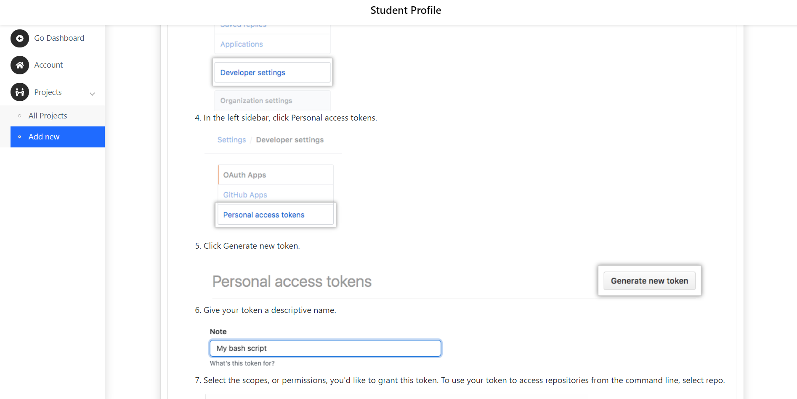
Get GitHub Access Token

Slide 31
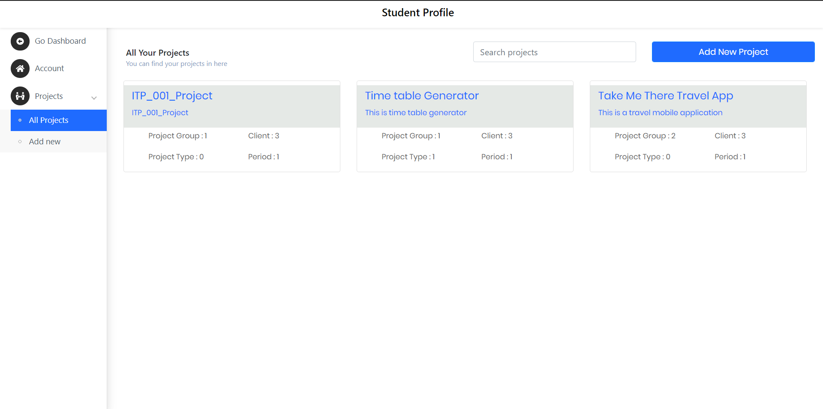
All Projects

Slide 32
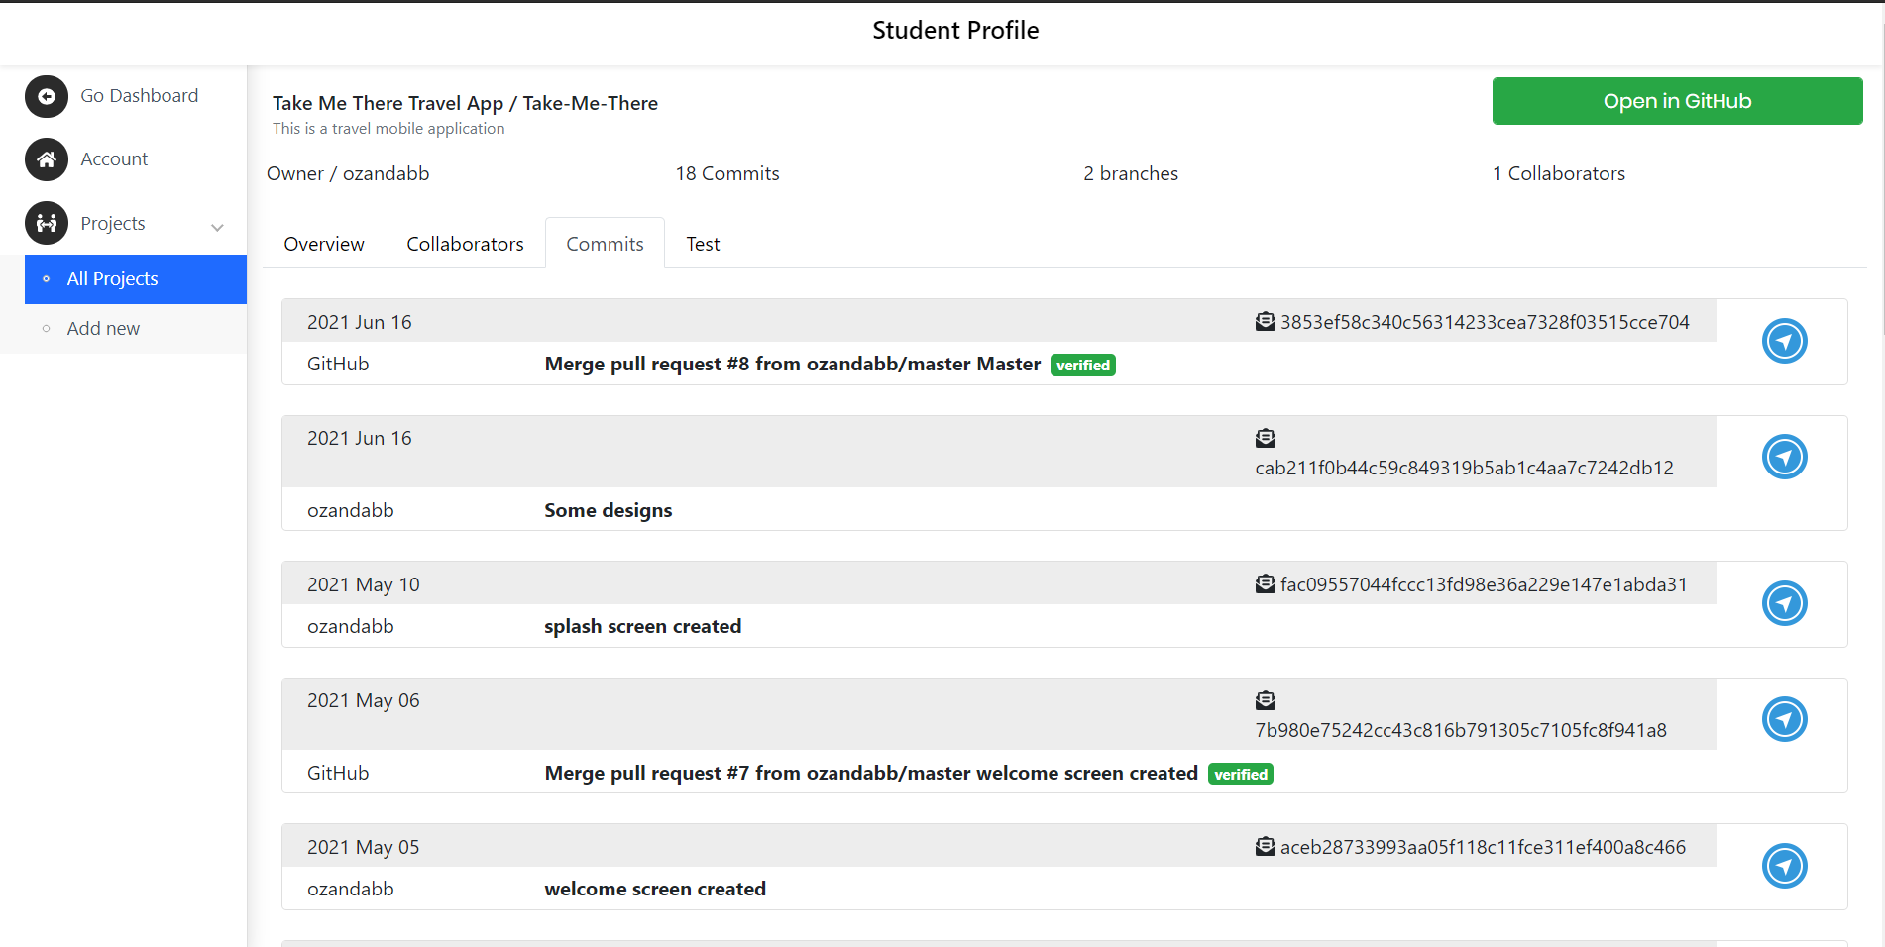
Single Project - Commits

Slide 33
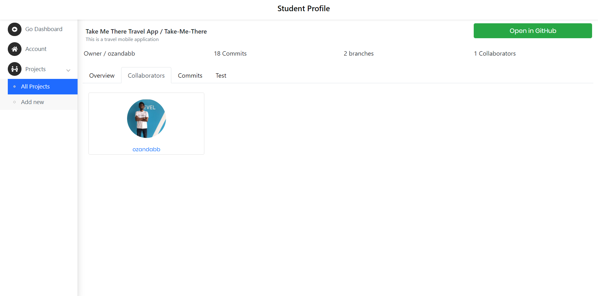
Single Project - Collaborators

Slide 34
Future works
Progress tracking future works
Prediction future works

Slide 35
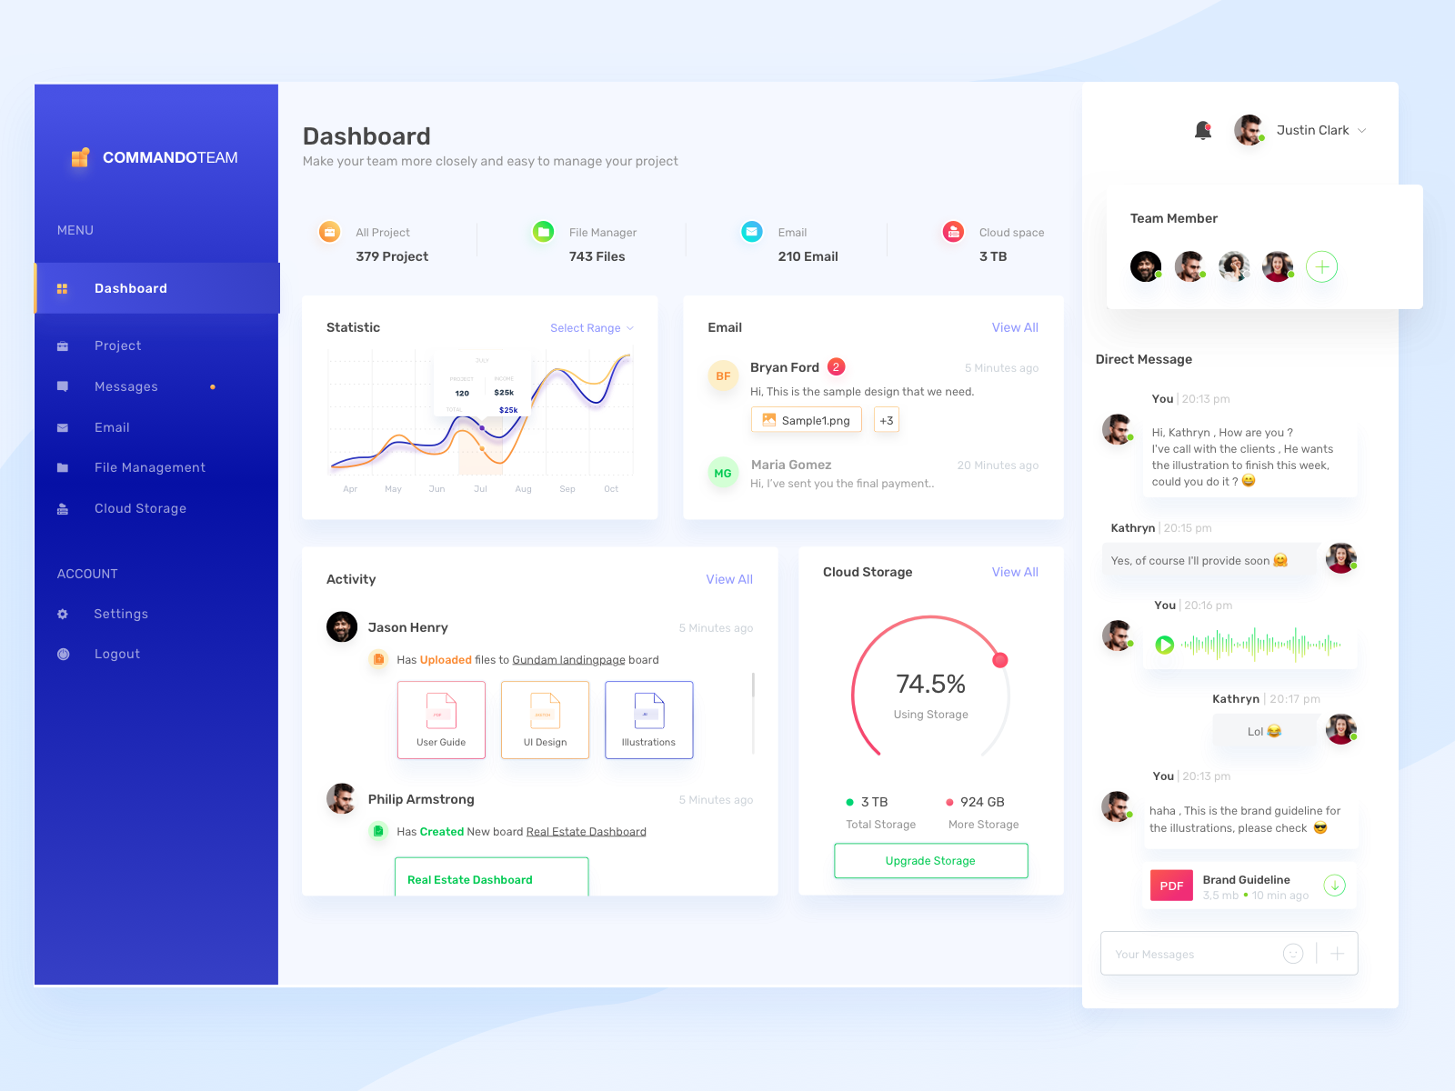


Progress Tracking Future Works
Need more progress in progress tracking
Use Graphs to display the progress.
Design UIs more attractively.
Create student Dashboard, Account

Slide 36


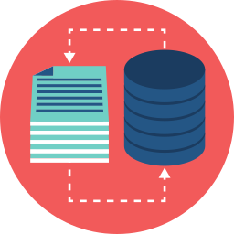
GitHub Prediction Future Works
No existing Dataset.
Create dataset with REST API.
Weekly Prediction with Supervised Learning.
Generating Performance report which represents individual contribution to the project by each team member.

Slide 37
References
[1] GitHub User insight using GitHub API – Data Collection and Analysis, Available at https://towardsdatascience.com/github-user-insights-using-github-api-data-collection-and-analysis-5b7dca1ab214
[2] GitHub Documentation Guide, ”Repositories”, Available at https://docs.github.com/en/rest/reference/repos
[3] GitHub Documentation Guide, “ Users “ , Available at https://docs.github.com/en/rest/reference/users
[4] IEEE, “Using Dynamic and Contextual Features to Predict Issue Lifetime in GitHub Projects”, 2016 IEEE/ACM 13th working Conference on MSR.
[5] Zhuang Liao, Mengjie Yi, Yan Wang, Shengzong Liu, Hui Liu and Yan Zhang, “Healthy or Not: A Way to predict ecosystem health in GitHub”, 28 January 2019

Slide 38

IT18129236 Isurindi H.G.P IT
Research Section 3
Track client meetings and document meeting content using voice to text conversion.

Slide 39
Introduction
Research Question
Objectives

Slide 40

Research Question
Can Students remember all the client requirements? Or what they communicated with the client?
Are there any existing systems for this research part?
Are students need to take notes in a meeting? Or Are Students need to remember all the details from the client meeting?
Can the client can track the project progress? And Can the client blame for the project coordinators for any failures?

Slide 41
Objectives
The main objective is Emotional and speech recognition into auto generated report and a satisfaction rate.
Sub Objectives
Creating client meeting platform
Client portal which provide facility to propose projects
Suggest Functions for students which inserted by students

Slide 42
Research Methodology
Methodology

Slide 43
Methodology
Client meeting tracking using voice-to-text converter and Emotional recognition to calculate client satisfaction rate
Created Client meeting platform
Created voice to text converter to track the client meeting.
Emotional recognition to calculate client satisfaction rate and generate a report of the meeting and the content
Student can check the meeting logs anytime. If they missed or forgot anything, they can check the meeting log.

Slide 44
Evidences
Evidences for the completion

Slide 45
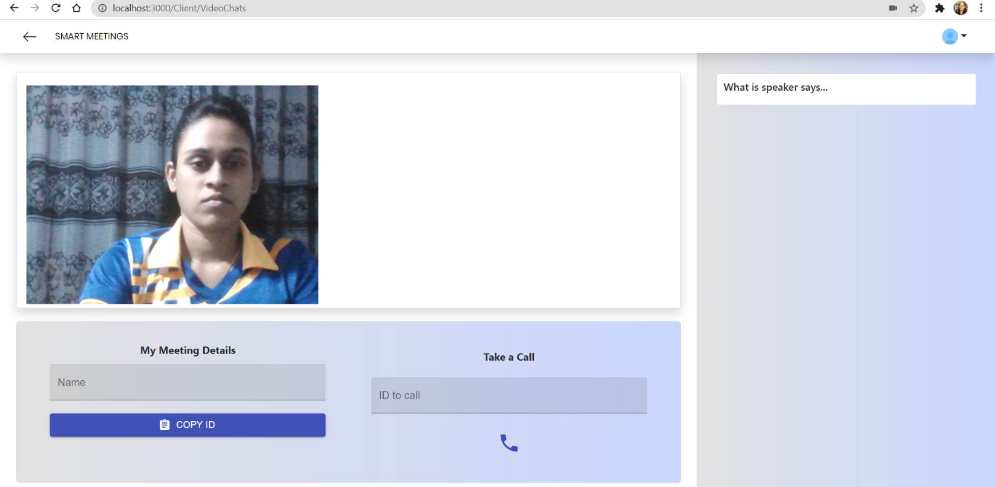
Client meeting platform

Slide 46
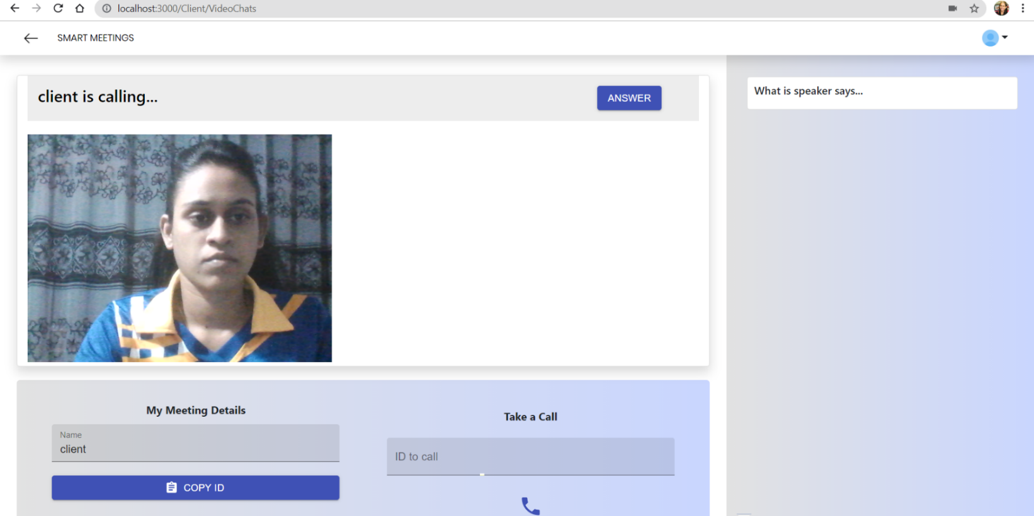
Call Receiving…

Slide 47
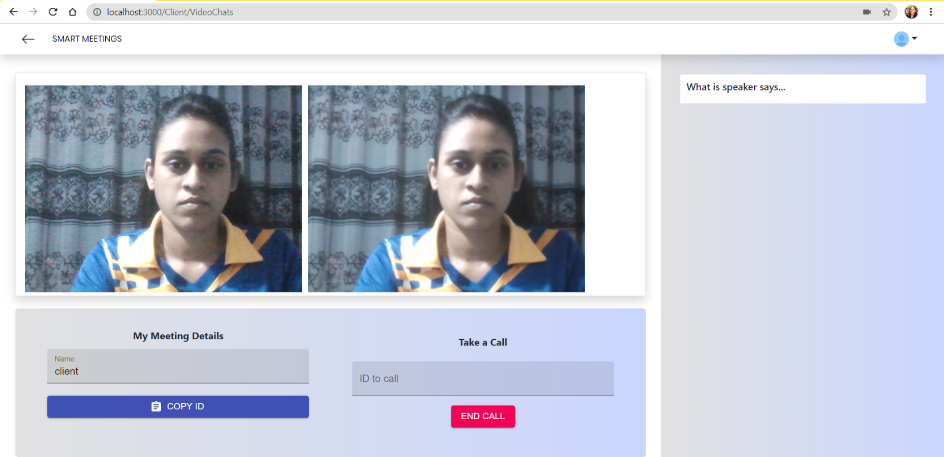
Answering the Call…

Slide 48
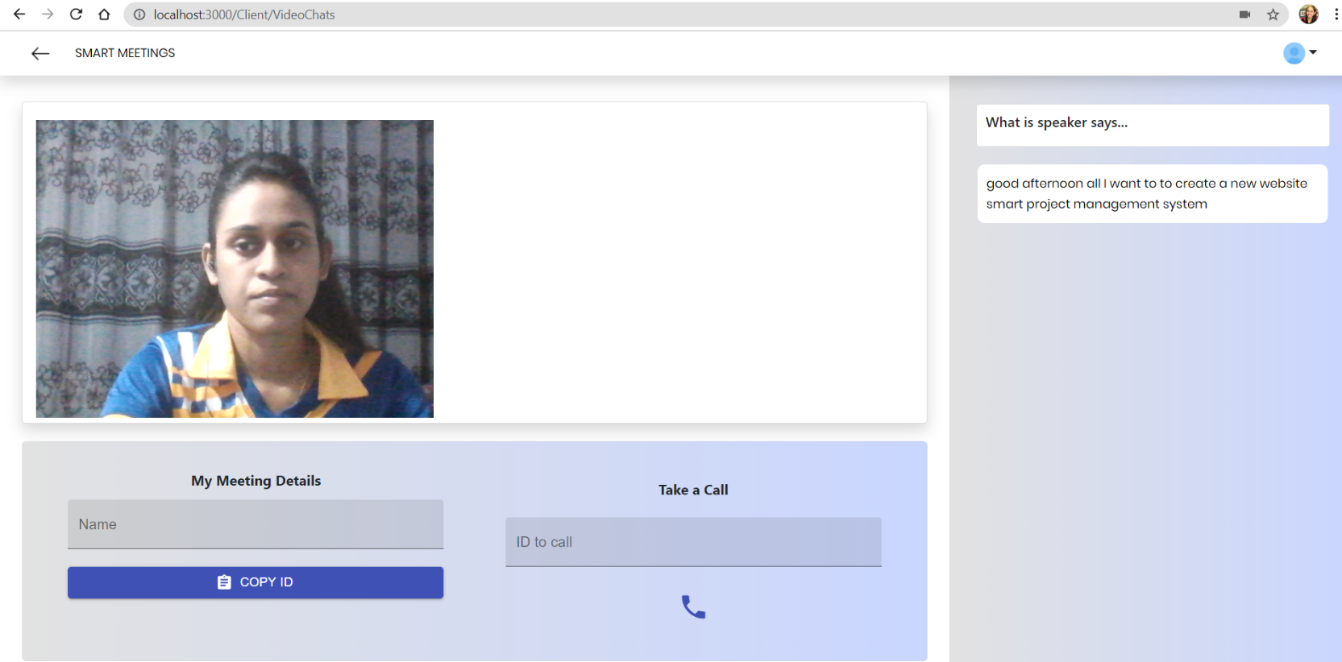
Convert voice to text

Slide 49
Future works
Voice to text converter to track the client meeting
Emotional recognition to calculate client satisfaction rate

Slide 50
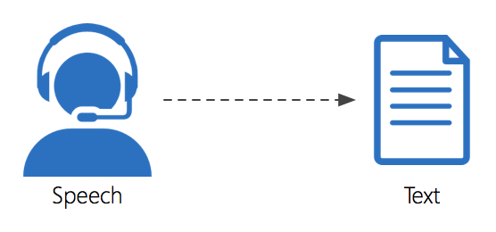

Voice to text converter to track the client meeting
need to integrate meeting platform and voice to text feature
Student can check the meeting logs anytime. If they missed or forgot anything, they can check the meeting log.

Slide 51

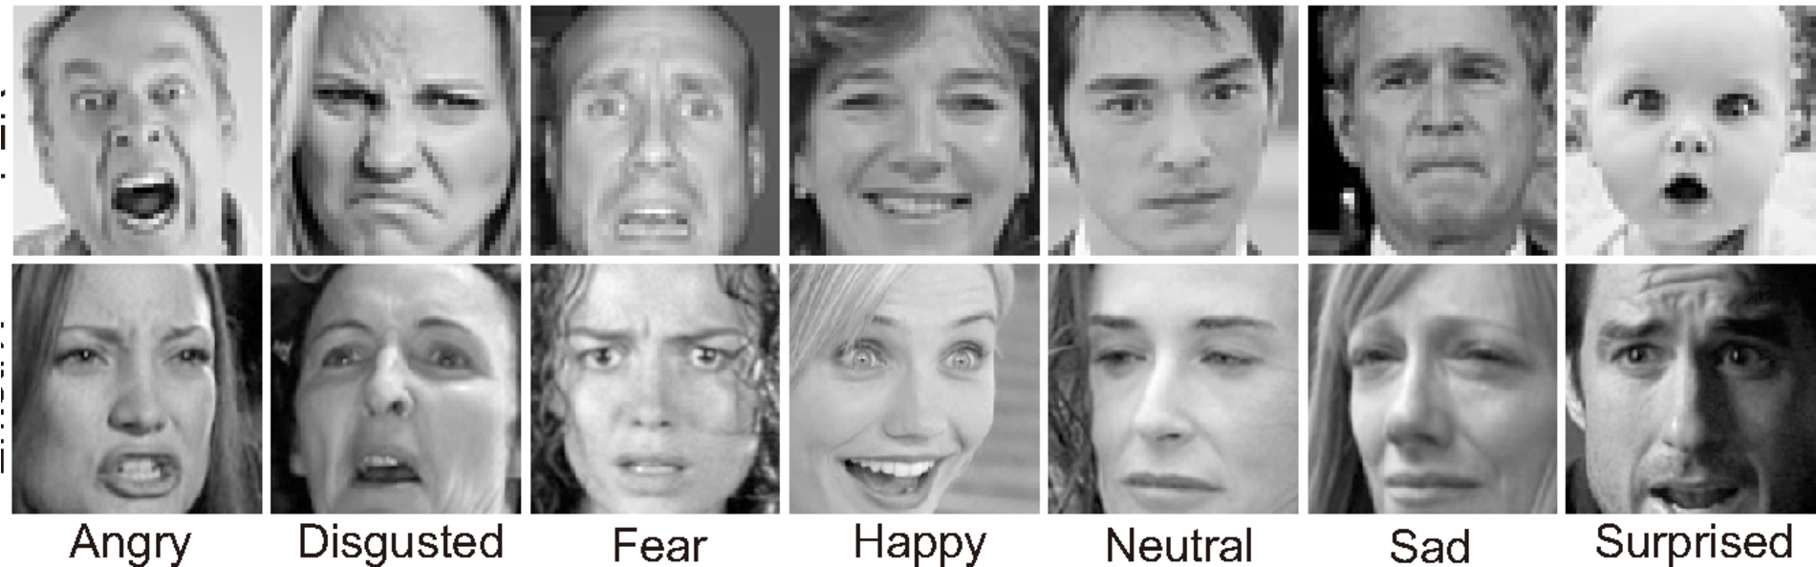


Emotional recognition to calculate client satisfaction rate
Using FER-2013 dataset.
Using deep learning as a model
deep face, opencv-python , matplotlib , tensorflow-gpu are the libraries going to use.

Slide 52
References
[1] Lowerre B.T. , “The Happy Speech Recognition System”, Ph.D. Thesis Carnegie-Mellon University, Pittsburgh, PA, Available at
[2] “Face recognition methods and applications” , Cornell University, 2014, Available at https://arxiv.org/abs/1403.0485
[3] Relationships between SCL theories and methods, adapted from Bishop and Verleger (Bishop and Verleger2013)
[4]The Free Rider and Cooperative Learning Groups: Perspectives from Faculty Members Geri McArdle Kimberly D. Clements Kim Hutchinson- Lendi
spech recognition website - https://realpython.com/python-speech-recognition/

Slide 53

IT18003642 Navanjana E.H.D.T.D. IT
Research Section 4
Peer Review Assessment

Slide 54
Introduction
Research question
Specific Objective
Sub objectives
Evidence for the completion

Slide 55

Research Question
How to detect Free riders in the group project?
Are there any existing methods for this research component?
What should be considered when measuring the review polarity?
Is this proposed review component generating the expected outcome?

Slide 56
Specific and Sub Objectives
Peer Review Assessments + Aspect Based Sentiment analysis
Specific Objective
Peer review mark generation based on monthly peer review reports
SA
Sentiment analysis is the automated process of analyzing text to determine the sentiment expressed (positive, negative or neutral).
ABSA
technique that takes into consideration the terms related to the aspects and identifies the sentiment associated with each aspect.

Slide 57
Specific and Sub Objectives
Sub Objective
Create a user interface to collect reviews from project groups.
Manage and concatenate reviews related to one student.
Generate report based on peer review to detect free rider
WBS
Work Breakdown
Structure

Slide 58
Research Methodology
Algorithms
Component progress
Future work

Slide 59
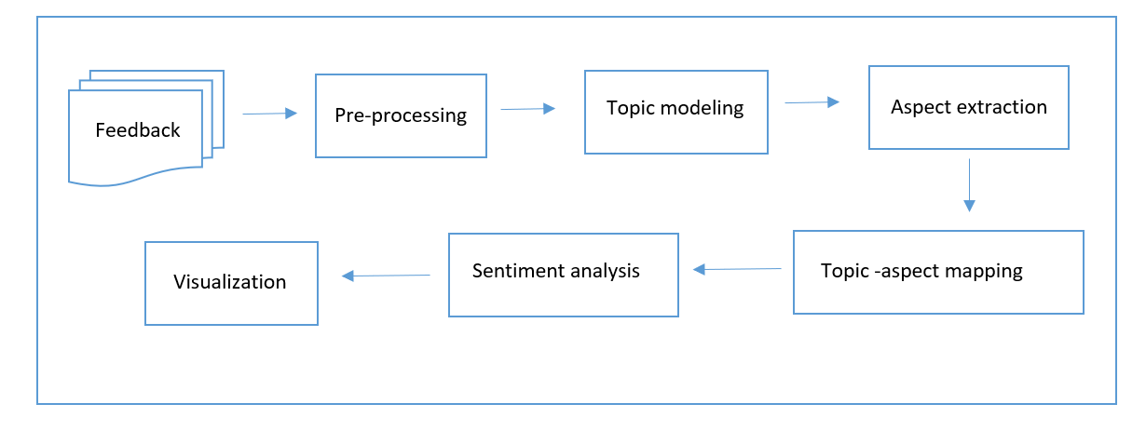
Research Methodology
A1
A3
A2
A1 - Topic Modeling and Topic Aspect Mapping , A2 - Aspect Specific Sentiment Analysis , A3 - Finding Aspect on Sentiments

Slide 60
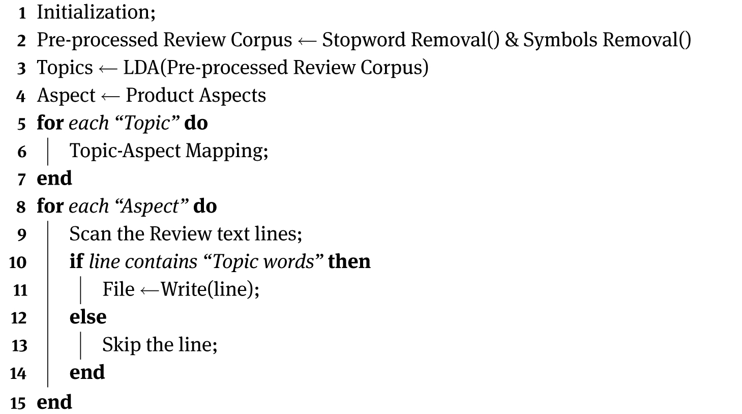
algorithm
Data
Student Review Corpus
Result
Aspect specific sentences

Slide 61
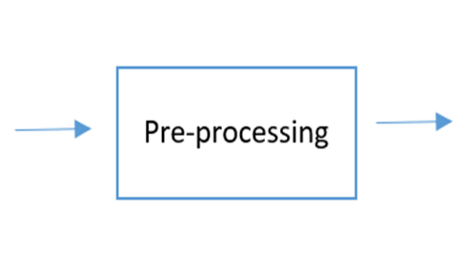
algorithm
Must Do:
Noise removal
Lowercasing
Should Do:
Simple normalization
Task Dependent:
Stop-word removal
Advanced normalization
Stemming / lemmatization
Text enrichment /augmentation

Slide 62

algorithm
Exploratory Analysis – Word Cloud
To verify whether the preprocessing, we’ll make a simple word cloud using the word cloud package to get a visual representation of most common words. It is key to understanding the data and ensuring we are on the right track, and if any more preprocessing is necessary before training the model.

Slide 63
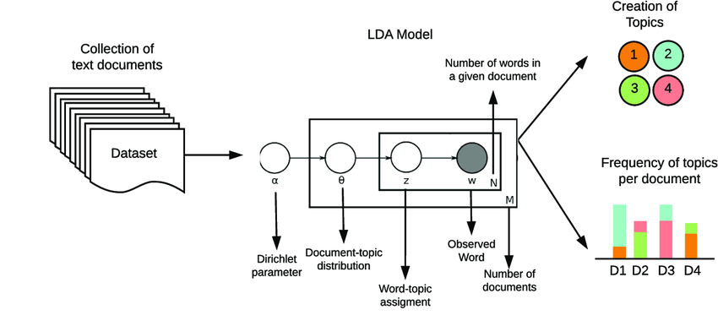
Component progress

Slide 64
Component progress
Sub Objective
Manage and concatenate reviews related to one student.
Merge CSV

Slide 65
Future work
Add ABSA/WBS components to modify the existing systems.
Algorithm 1 : Topic Modeling and Topic-Aspect Mapping
Data : Student Review Corpus
txt - nltk
csv - pd papers
Result : Aspect specific sentences
ITP + ABSA + WBS
Active Learning Environment

Slide 66
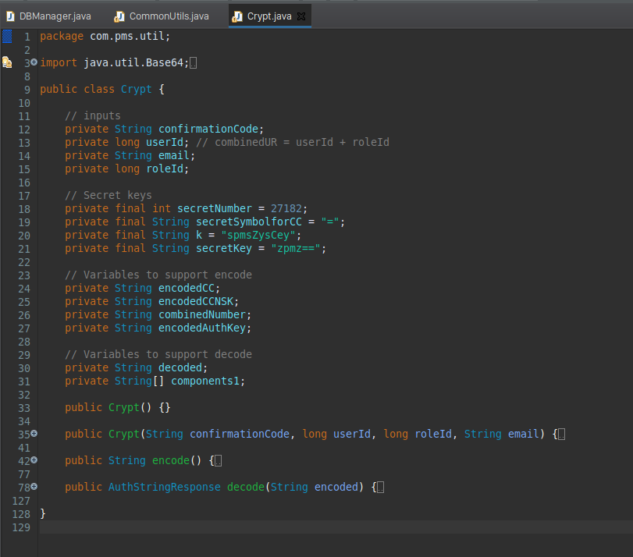
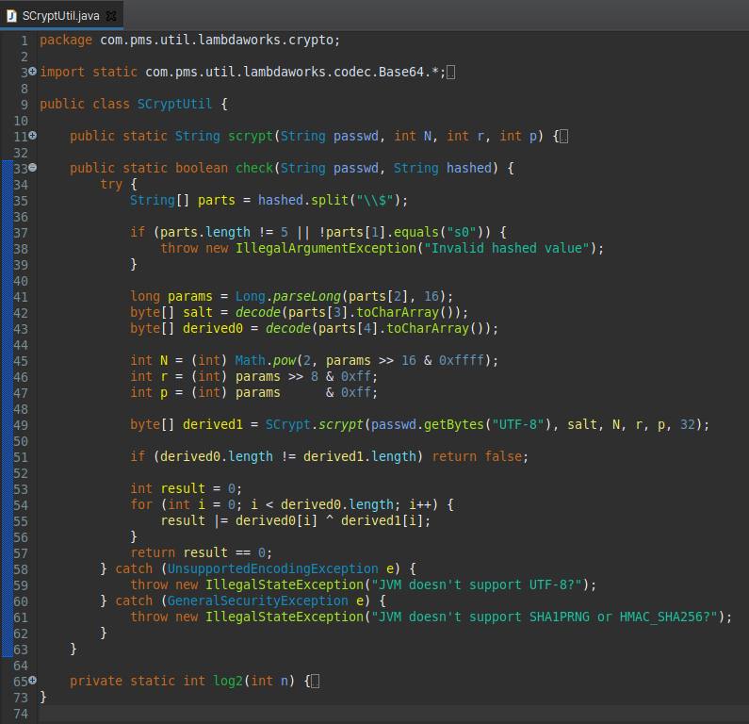
Risk Mitigation

Slide 67
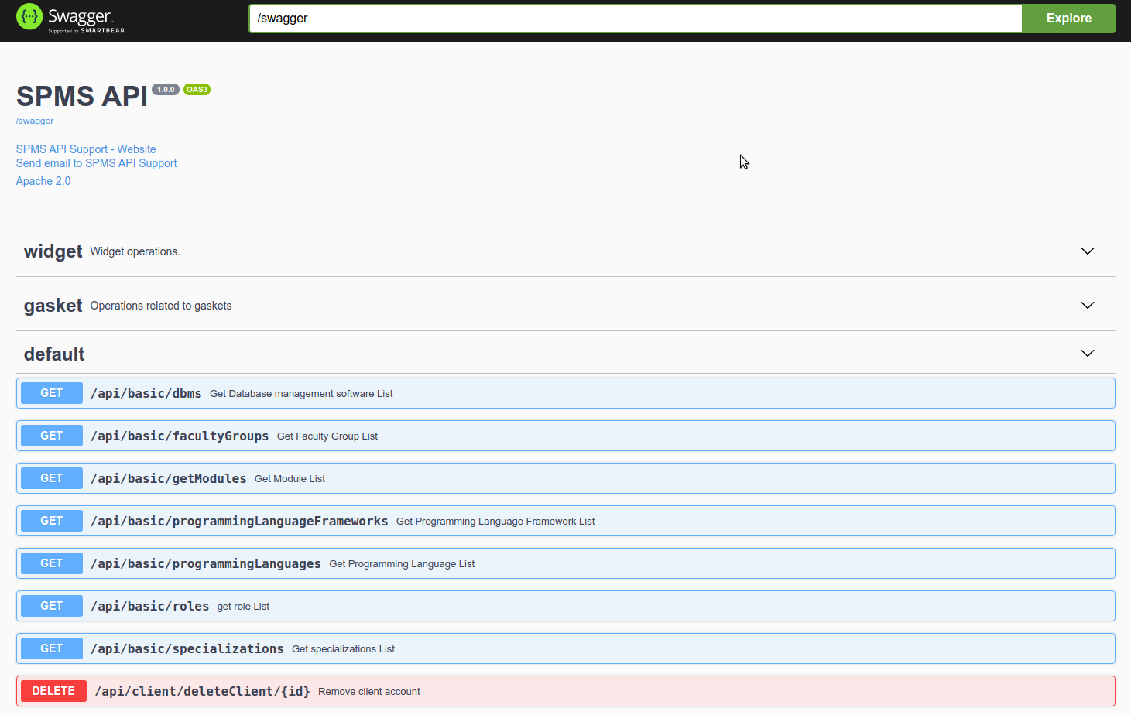
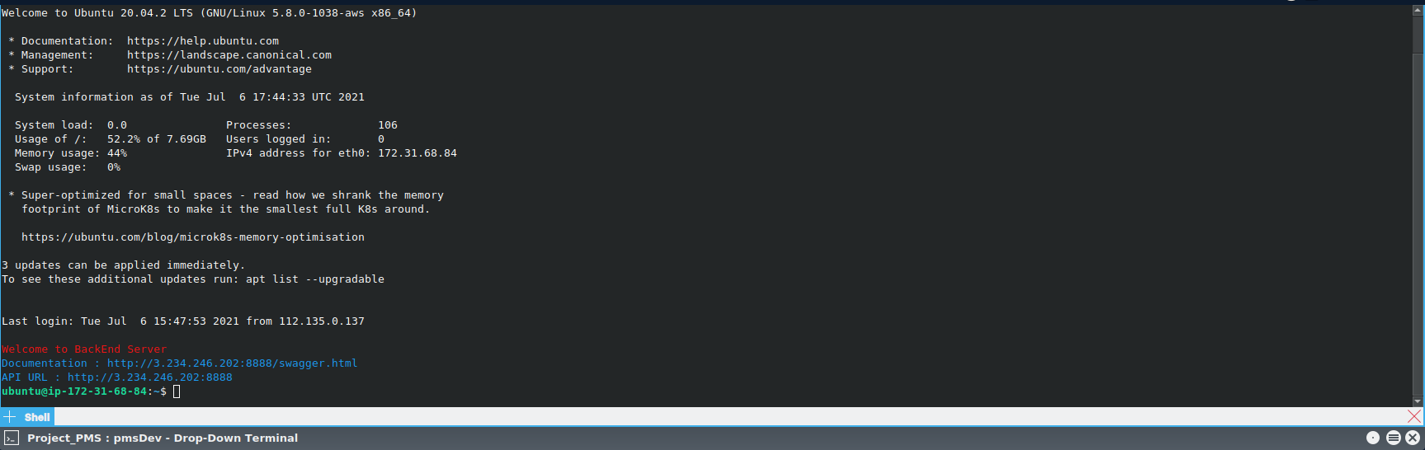
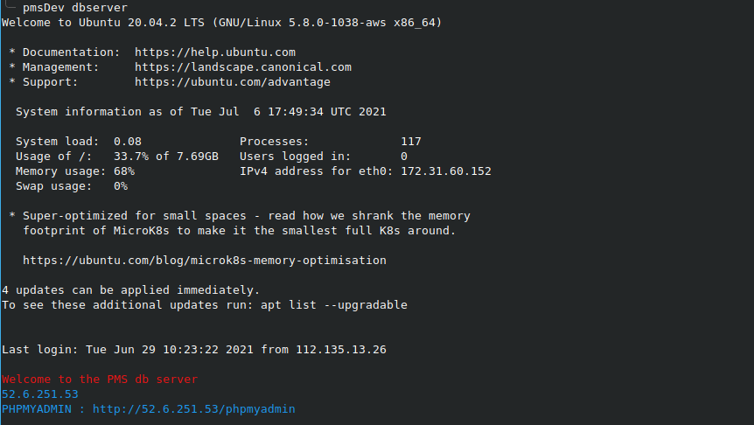
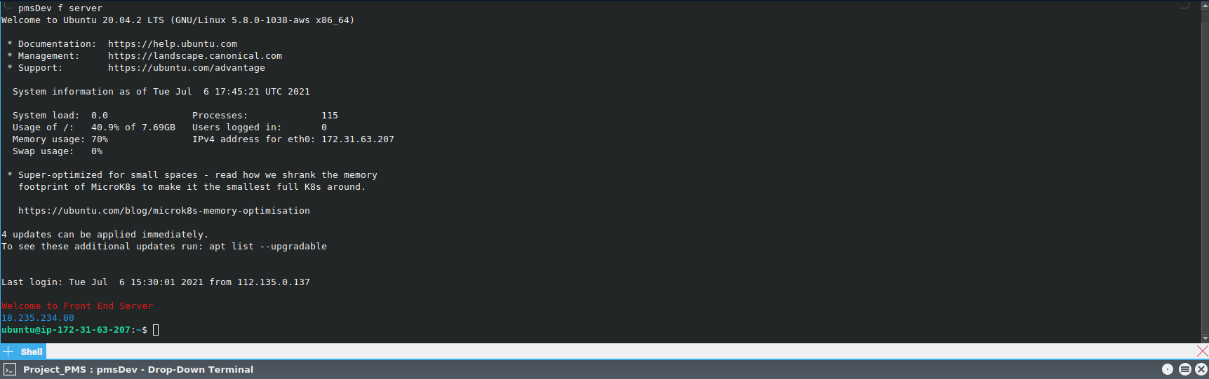
Standards and Best Practices

Slide 68


Commercialization
Users can download the free trial version with limited functionalities to a limited time period and if user satisfy with the product, They can purchase the system for the full price.
Since the target users are the universities, We can offer discounts for the product and they might considering to use the product.

Slide 69


